Slide 1



Final project -Tiago Quaresma Simões, PT_DA_SEP2023

Slide 2

AGENDA
01
OBJECTIVES
02
TOOLS
03
FUTURE IMPROVEMENTS
04
WEB APP DEMONSTRATION
05
Q&A

Slide 3




OBJECTIVES
START
POINT
Basic recording functionality.
Limited to manual operation or scheduled recording.
Require manual monitoring and review of footage for any incidents after they have occurred.
Lack of advanced features like motion detection, facial recognition, or object tracking.
Requires much more storage since its always recording.
Offer remote access and control via smartphone or computer.
Utilizes motion detection to trigger recordings and alerts. (in real-time)
Provides smart storage.
Can distinguish between human movement, animals, and other objects.
Provides customizable settings for specific security needs.

Slide 4






TOOLS
PYTHON
HTML
CSS

Slide 5



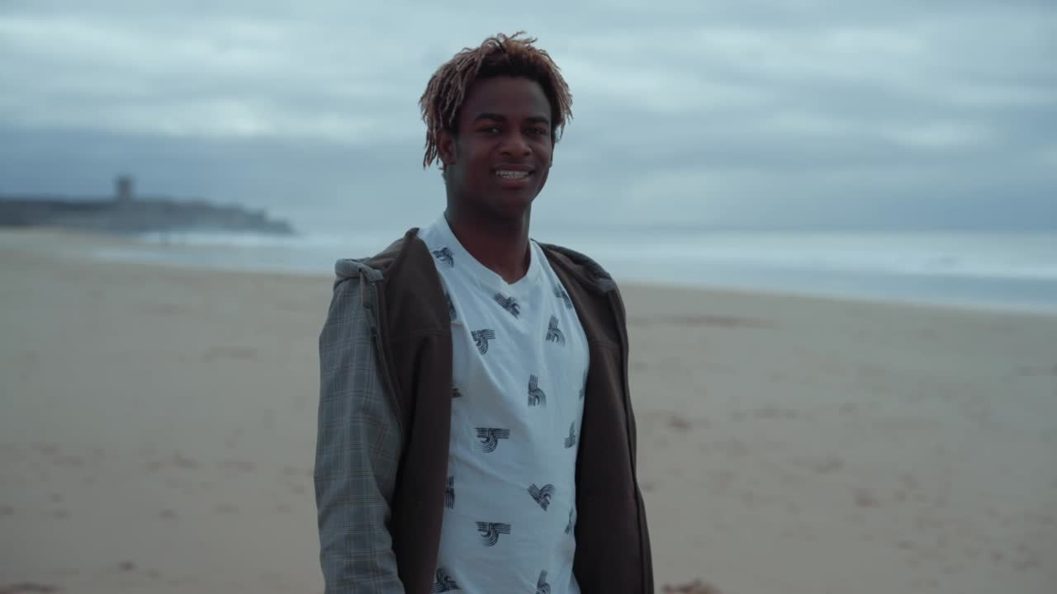

FUTURE IMPROVEMENTS
911
Migrate to cloud because the web app was built On-Prem.
Create an app for both Android and iOS.
Develop the possibility of switching off the Security Camera using pre-defined gestures and also draw the security area.
Develop the option to call the local police station and send the record.
Deploy on domestic drones that map the home, and make periodic check-ups.

Slide 6
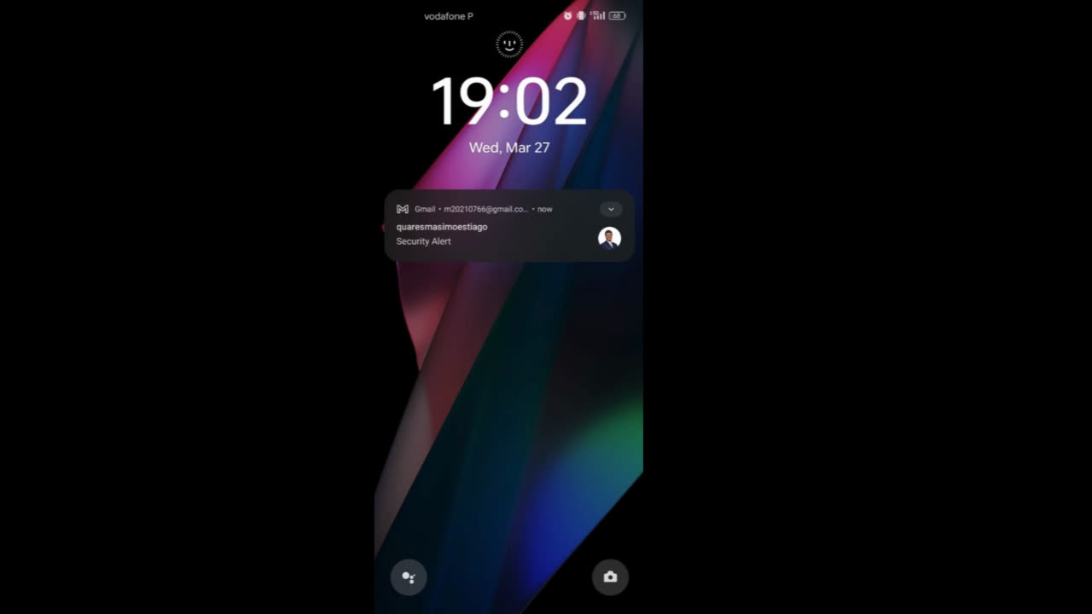


WEB APP

Slide 7

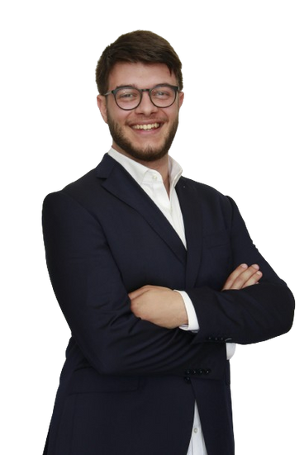

QUESTIONS & ANSWERS
Thanks for
your attention!

Slide 8

